Slide 1
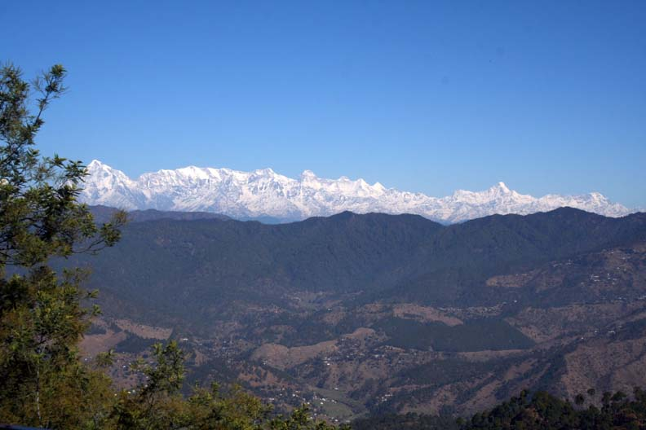
Integrated Land and Water Management for Ecosystem Restoration and Climate Change Adaptation in Hindu Kush Himalaya
Prakash C. Tiwari
Professor of Geography
Kumaon University
Nainital, Uttarakhand, India
Email:pctiwari@yahoo.com

Slide 2
Mountain Are Critical For Global Sustainability
Mountains share 24% global land surface are home for 12% people
Nearly 70% population receives freshwater supply from mountain headwaters
The largest trans-boundary river systems of the planet have their origin in high mountains
Mountains have still the largest proportion of world’s forests which not only constitute global biodiversity hot spots and the pool of genetic resources
However, mountains have long been marginalized from the view point of sustainable development of their resources and inhabitants
Currently, mountain ecosystems as well as mountain communities are particularly threatened by the ongoing processes of environmental global change
Nearly 90% mountain population live in developing or transition countries which constitute some of the poorest and marginalized people of the world
Hindu Kush Himalaya constitutes headwater of South Asia, but it has access to less than 5% global fresh-water resources
Himalaya is the most densely populated mountain which is inhibited by humans above an elevation of 5000 m
Hindu Kush Himalaya would play very crucial role not only in attaining water, food, livelihood and health security and climate change adaptation, but also in alleviating poverty and even in ensuring peace in South Asia

Slide 3
Global Change and Mountain Ecosystems
DRIVERS
ECSYSTEM IMPACTS
VULNERABILITY
TO MULTIPLE
NATURAL RISK
SOCIO-ECONOMIC IMPLICATIONS
Population Growth
Deforestation
Rapid Urbanization
Accelerated Erosion
Loss of Biodiversity
Infrastructure
Development
Tourism Growth
Debris &
Mud Flow
Groundwater Disruptions
Infrastructure Development
Employment
Riverbeds Siltation
Soil Loss
Market Access
Economic
Globalization
Snow &
Glacial melt
Landslides
Water, Food. Livelihood & Health Insecurity
Flash Floods, Floods & Droughts
Resource Exploitation
Rainfall Variability
Increased
Out-migration
Land Use Change
Reduced Water Availability
GLOF
Climate Change

Slide 4
Hindu Kush Himalaya Represents one of the Most Vulnerable Mountain Ecosystems of the Planet
Natural
Vulnerability
Anthropogenic
Vulnerability
High Altitude
Steep Slopes
Geo-tectonically Alive
Young Mountains
Climate Change
Densely Populated
Severely Limited Arable Land
Limited Livelihood Options
Subsistence Economy
Underdeveloped
Remoteness
Poor Accessibility
Political Marginalization
Increased Out-migration

Slide 5
LAKE REGION DISTICT NAINITAL Land Use Changes (1981– 2012)
N
Nainital
Bhowali
Bhimtal
Jeolikote
LEGEND
Forest – D. Forest
Forest – Lantana
Forest – Plantation
Forest – Fallow Land
Forest – Settlement
Forest – Others
Cultural Features – Oak Forest
Cultural Features – Pine Forest
Cultural Features – D. Forest
Cultural Features – Plantation
Lakes
No Change area
o
Km 2 1 0 1 2 Km

Slide 6
Annual Rainfall Decreased: 11% Number of Rainy-days Declined: 15%
Ground Water Status in Kosi Headwater (Rawat 2012)
1981
Temporary Water Table
Permanent Water Table
Water Reserve
km
2012
Temporary Water Table
Spring Dried
Permanent Water Table
Spring Dried
Water Reserve
km

Slide 7
Hydrological Responses of Himalayan Watersheds: Maximum Flood Rate
1.670
In Comparison to Oak Forest flood rate is nearly 35 times higher in urban land use
0.836
m3/ Sq km/second)
0.422
0.260
0.048
Oak Forest Pine Forests Barren Land Cultivated Land Urban Systems

Slide 8
Hydrological Responses of Himalayan Watersheds: Overland Land Flow Per Cent of Total Rainfall
Oak Forest: 3.50%
Pine Forest: 5.60%
Urban Systems: 65.00%
Cultivated Land: 15.00%
Barren Land: 25.00%

Slide 9
Integrated Land and Water Management Approach
Water Availability
Utilization & Access
Integrated Resource
Management
Precipitation
Location-Altitudinal Transact
Critical Headwater/Watersheds
Ground
Interactions
Land Use Planning
Geology, Soils, Slope, Aspect, Drainage
Water Demand (Agriculture, Domestic, Industry etc.)
Traditional Water Management System & People’s Priorities
Run-off
Water Conservation Measures
Land Use Pattern
Economic Viability
Income Generation
Groundwater
Food, Livelihood & Heath
Technical Feasibility
Water Discharge
(Springs & Streams)
Gender Sensitization
Social Structure
Social Equity
Water Quality
Adaptive Water Management: Demand Prioritization, Rainfall Variability, Extreme Events
Water Availability
Water Price
Multi-stakeholders Governance
Knowledge Generation Validation &
Synthesis
Conceptualization,
Decision &
Planning
Implementation, Monitoring & Assessment
Institutionalization
and
Sustainability

Slide 10
Natural Resources Information System for Integrated Land and Water Management
Land Use
Land Use Planning
Climatic Data
Natural Resources
Inte-grated Land & Water Manage-ment
Precipitation
Terrain Characteristics
Temperature
Disaster Mapping
Extreme Event History
Management Options for Different
Land Use Categories
Disaster Vulnerability
Adaptation Programme, Disaster Risk Reduction
Adaptive Resource Manage-ment
Headwater Prioritization
&
Management
Water Availability
Livelihood & Food Systems
Resource Ownership

Slide 11
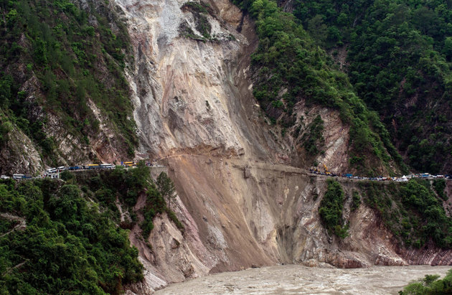
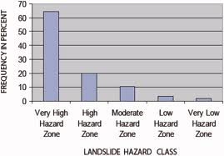
LAKE REGION DISTRICT NAINITAL
NATURAL RISK VULNERABILITY
Very Low
Low
Moderately Low
Moderate
High
Very High
% Cultivated Land & Settlements

Slide 12
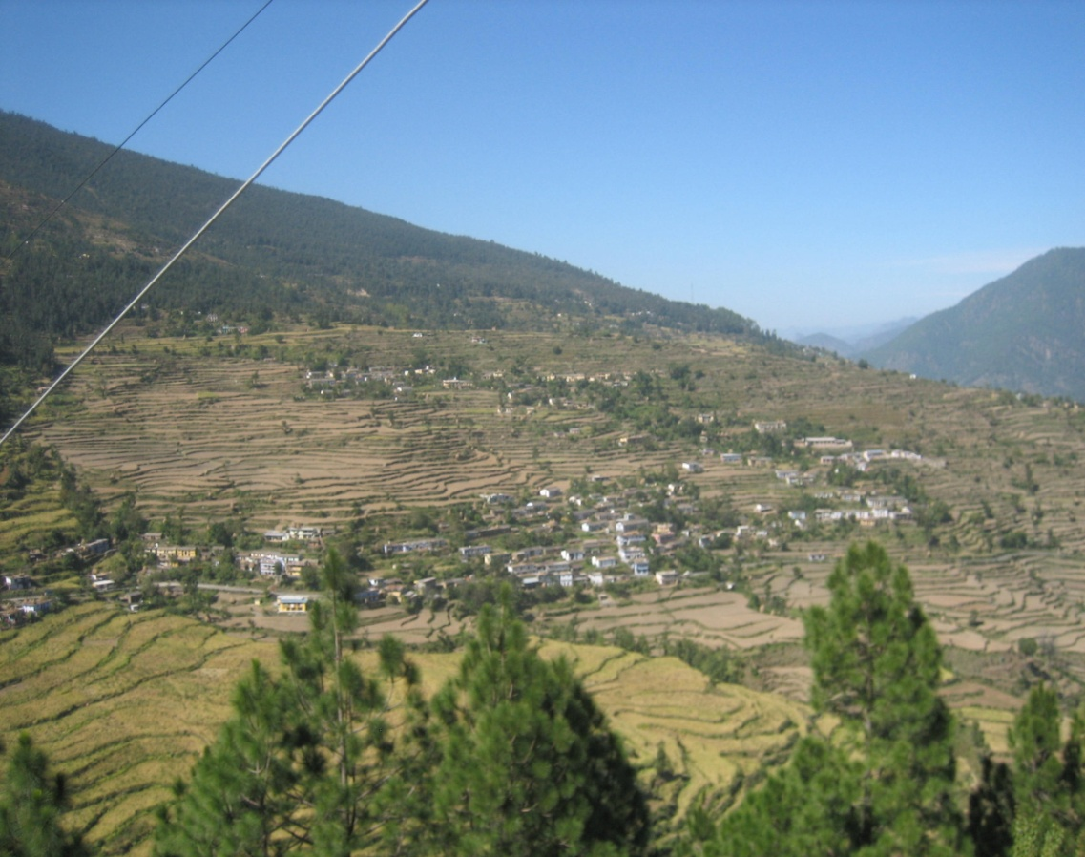
LAKE REGION DISTRICT NAINITAL
ADAPTIVE LANDUSE
Settlements (5%)
Forest (62%)
Agriculture (20%)
Horticulture (7%)
Water Conservation (4%)
Settlements (5%)
Water-bodies (2%)
Water Conservation (4%)
Water-bodies (2%)
Horticulture (7%)
Cultivated Land (20%)
Forest (62%)

Slide 13
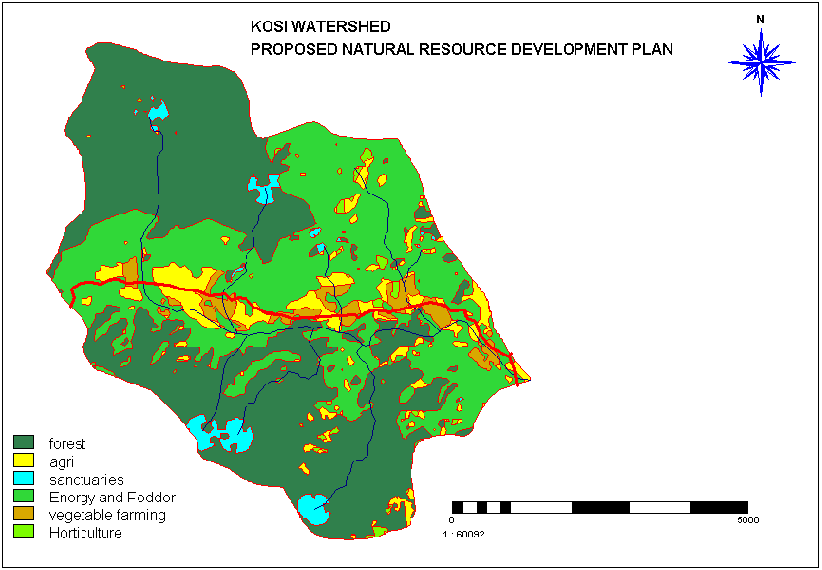

MICRO-WATERSHED LEVEL
INTEGRATED LAND AND WATER MANAGEMENT OPTIONS
N
LEGEND:
Reserved Forest
Community Forests
Horticulture & Tea Farming
Cultivated Land
Vegetable Farming
Water Conservation Sites

Slide 14
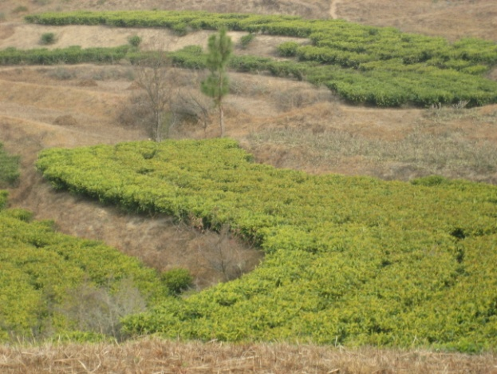
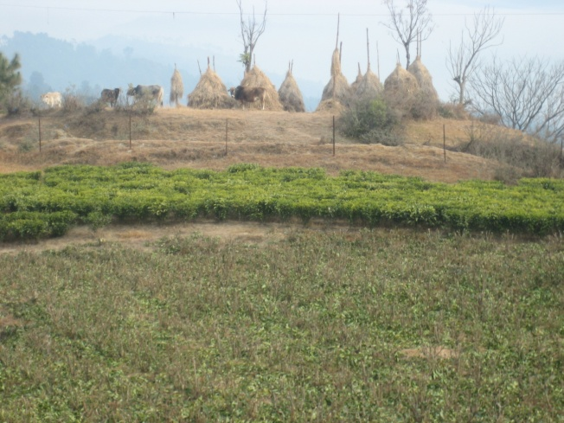
VILLAGE LEVEL
INTEGRATED LAND AND WATER MANAGEMENT FRAMEWORK
SAIL AND BUNGA
LEGEND:
N
Spring Sanctuaries
Fodder & Horticulture Development
Energy Development & Medicinal Plants
Horticulture & Tea Farming
Agriculture
Catchment Treatment, Check Dams, Ponds
500 m 0 500 m
Fig. 4

Slide 15
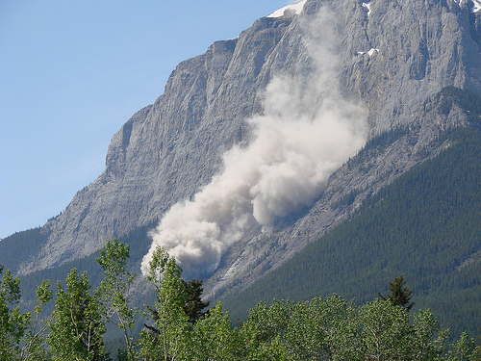
Thanks You!

